Slide 1
MACHINE
LEARNING
Breaking Down

Slide 2
TABLE OF CONTENTS
01
03
03
05
06
What are the Pre-requisite and Don’ts
What is ML?
Learning Path to Follow
How to think about the Problem Statement
07
02
08
Resource Sharing
Why there is a need to learn ML, Today ?
How to progress and participate in competitions
09
04
Categories in ML
03
Some Important Bookmarks
Real Life Use Cases of ML
10
11
Community Contribution

Slide 3
What is Machine Learning ?
01
A computer program is said to learn from experience E with respect to some class of tasks T and performance measure P, if its performance at tasks in T, as measured by P, improves with experience E.

Slide 4
Machine Learning is the training of a model from data that generalizes a decision against a performance measure.

Slide 5
Test Time !
Question No. 1
Let Suppose you have a lot of historical weather data to the learning algorithm, and have it learn to predict the weather. Then what is P according to you?
The process of the algorithm examining a large amount of historical weather data.
The task to predict the weather.
The probability of it correctly predicting the weather of future date’s.
Analysis of the historic weather data.

Slide 6
Test Time !
Question No. 2
Let Suppose you have a lot of historical weather data to the learning algorithm, and have it learn to predict the weather. Then what is E according to you?
The process of the algorithm examining a large amount of historical weather data.
The task to predict the weather.
The probability of it correctly predicting the weather of future date’s.
Analysis of the historic weather data.

Slide 7
AI VS ML VS AGI

Slide 8

AI

Slide 9


Slide 10
Why there is a need to learn ML, Today
03

Slide 11
Categories in ML
Input
Data With Labels
Data Without Labels
States + Actions
Supervised
Learning
Unsupervised
Learning
Reinforcement
Learning
Error
Targets
Mapping
CLasses
Action
Output

Slide 12
Different Types of Classification:
Binary classification
Multi-class classification

Slide 13
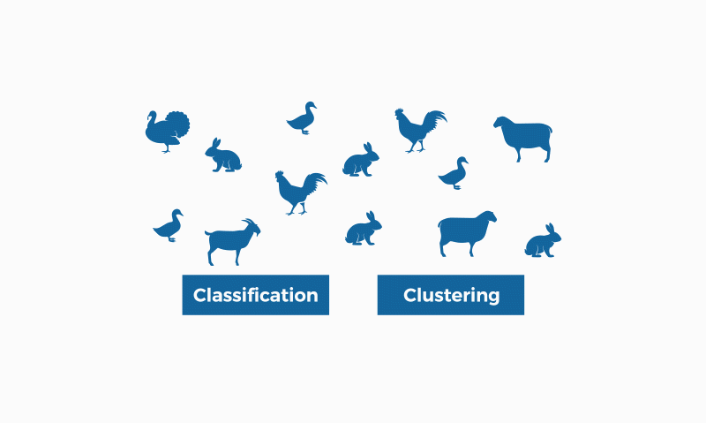
Different Types of Classification:

Slide 14
Different Types of Classification:
Binary classification
Multi-class classification
Hierarchical classification
Probabilistic classification
Rule-based classification
Neural network classification
Instance-based classification

Slide 15
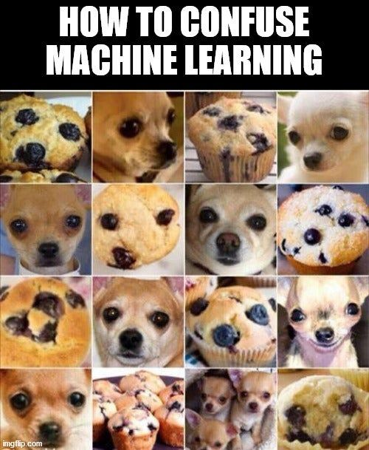

Slide 16
How to enchance the accuracy in classification:
Feature Selection
Data Pre-processing
Algorithm Selection
Ensemble Methods
Cross-validation
Hyperparameter Tuning
Increase Training Data

Slide 17
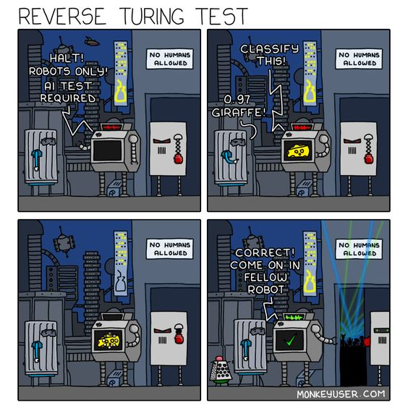

Slide 18
Understanding Clustering:
Imagine you are a pizza restaurant owner, and you want to group your toppings together based on which ones are the most popular. You ask your customers to fill out a survey about their favorite pizza toppings, and you get the following results:
Pepperoni, sausage, and bacon are the most popular toppings.
Mushrooms, olives, and onions are the next most popular toppings.
Pineapple and anchovies are the least popular toppings.
Using clustering, you can group the toppings into three clusters:
The meat lovers cluster: Pepperoni, sausage, and bacon
The veggie lovers cluster: Mushrooms, olives, and onions
The oddballs cluster: Pineapple and anchovies
Now, you can use these clusters to create fun pizza combinations that cater to different tastes. For example, you could create a "meat lovers" pizza with all three of the most popular toppings, a "veggie lovers" pizza with the next most popular toppings, or an "oddballs" pizza with pineapple and anchovies (for those brave enough to try it!).
So, clustering is like grouping your pizza toppings into categories based on their popularity, and then using those categories to create fun pizza combinations that cater to different tastes.

Slide 19

Understanding Clustering:

Slide 20
Overview Various Domain in Machine Learning:
Supervised Learning
Unsupervised Learning
Reinforcement Learning
Deep Learning
Transfer Learning
Time Series Analysis
Bayesian Learning

Slide 21
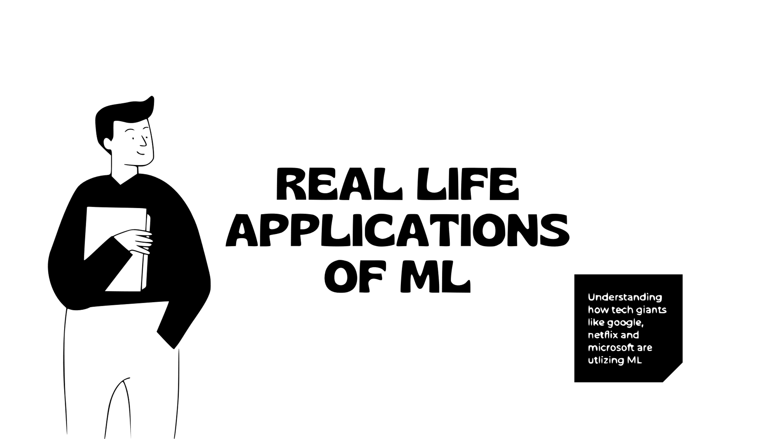

Slide 22

GOOGLE
Supervised Learning
Google is said to be using state of the art spam detection machine learning algorithm such as logistic regression in its classification of emails. In this problem, you have to classify each input into a category, e.g., spam or non-spam. In this, the output will always be a discrete value(e.g.: 0 and 1).
GMAIL SPAM FILTER

Slide 23

NETFLIX
Unsupervised Learning
Unsupervised Learning Netflix uses different unsupervised methods like clustering , filtering, association etc. Netflix uses clustering algorithms like K-means or hierarchical clustering. This sort of approach helps in customer segmentation and personalized recommendations.
NETFLIX RECOMMENDATION SYSTEM

Slide 24

MICROSOFT
Reinforcement Learning
Reinforcement Learning Microsoft has used Reinforcement Learning on their Azure Al platform. These models can learn from environmental cues, expert feedbacks or customer behavior in real time. They use this method internally across windows, edge. teams and Xbox. This has resulted in an overall growth.
MICROSOFT TEAMS`

Slide 25
Test Time !
Question No. 3
Details:
Room Count
Lot Size
Model
House
Value
What approach should be followed?
Regression Task
Classification Task
Reinforcement Task
Clustering Task

Slide 26
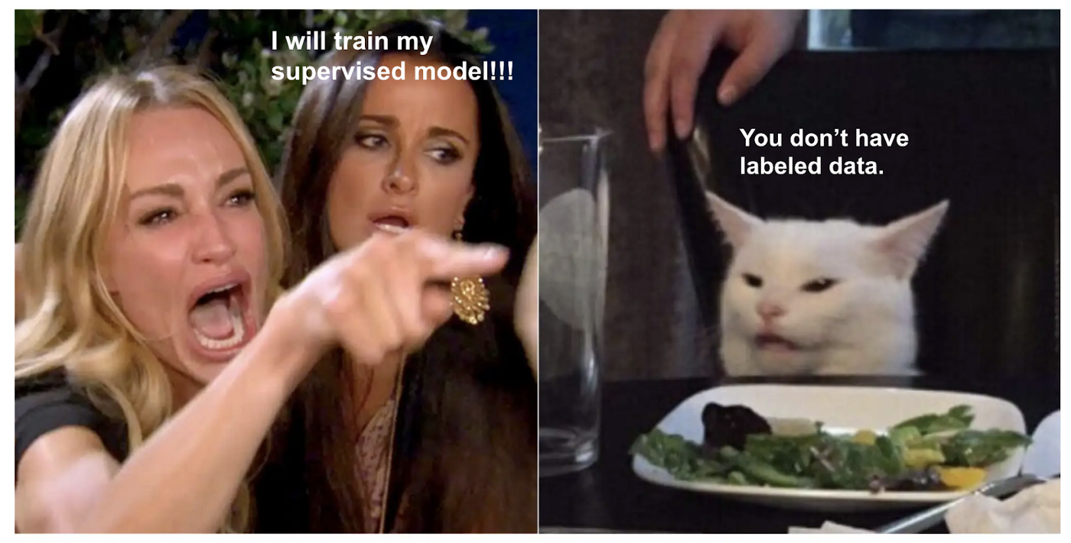

Slide 27
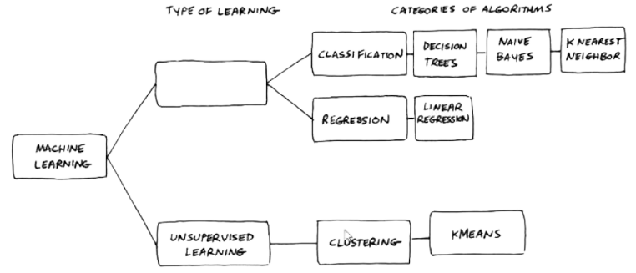
Test Time !
Question No. 4
Fill in the Box:
Training Set
Testing Set
Supervised Learning
Reinforcement Learning

Slide 28
Test Time !
Question No. 5
Assume, you are working on the prediction of the temperature of future date’s on the basis of different features. So you will consider which type of task it lies in?
Regression Task
Classification Task
Reinforcement Task
Clustering Task

Slide 29
Test Time !
Question No. 6
Assume, you are working on the project of weather forecasting and you need to predict whether there will be rainfall or not on Monday. So you will consider which type of task it lies in?
Regression Task
Classification Task
Reinforcement Task
Clustering Task

Slide 30
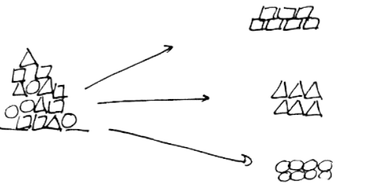
Test Time !
Question No. 7
Which Type of Classification Task is performed below:
Binary Classification
Multi Binary Classification
Multi Class Classification
Reinforcement Classification

Slide 31
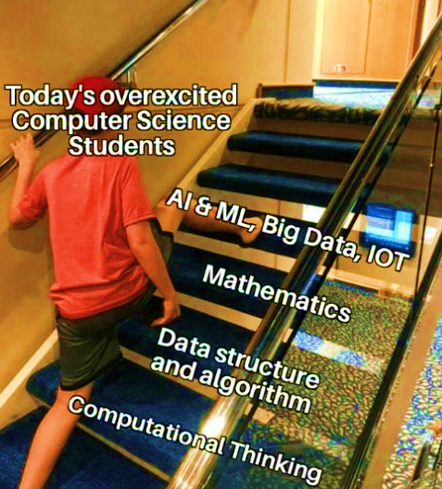
0

Slide 32
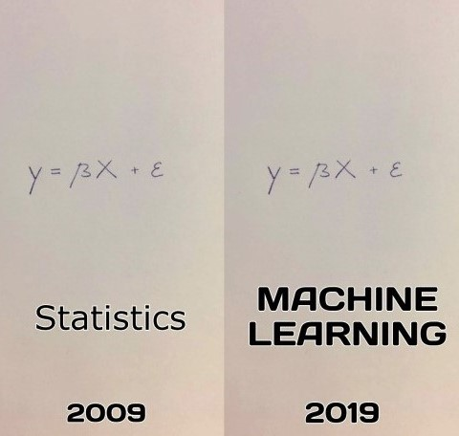
“Fancy frameworks (e.g. PyTorch, TensorFlow) are for the present, but math and statistics are for eternity!” - Code Basics

Slide 33
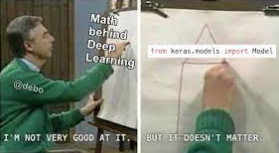
Importance of Mathematics in Machine Learning

Slide 34
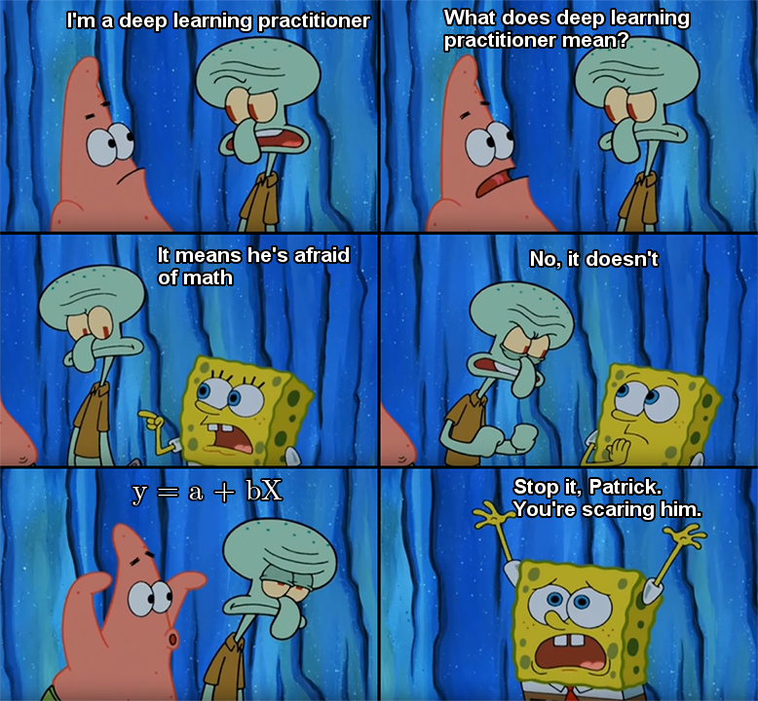
Mathematics in Machine Learning Resources
MIT OpenCourseWare
Mathematics for Machine Learning (Coursera)
Machine Learning Crash Course (Google)
Data Science Mathematics
Machine Learning Mastery

Slide 35
STAGES TO FOLLOW FOR MACHINE LEARNING

Slide 36

COURSES

Slide 37

Best ML Resource:

Slide 38





YOUTUBE RESOURCES
Krish Naik
DeepLearning.AI
CodeBasics
Steve Bruton
3blue1brown

Slide 39



Having some Bookmarks is Good!
DataMahadev
Sky Towner
The Batch
Paper with Code
Analytics Vidhya
Towards Science
Medium
KDnuggets
Special Repository Mentions:
Applied ML

Slide 40




Websites for Competition
Machine Hack
DPhi
Vidhya Analytics
(DataHack)
Kaggle

Slide 41
Thank You

